Slide 1
hotel management
System
Kristen Thomas

Slide 2
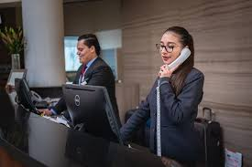
Problem statement Pt. 1
Hotel management systems are utilized by most hotels around the world to handle the large volume of guests, rooms, and other information they must handle securely.
Since hotels are the most utilized accommodations when traveling, it is important that they can accurately store all the guests personal and booking information and streamline this process.

Slide 3
Problem statement pt. 2
Creating a kiosk or app where guests can access their information and check in or check out will allow for an expedited process when staying or leaving a hotel.
Guests can review their reservation information or hotel information easily through a lobby kiosk.

Slide 4
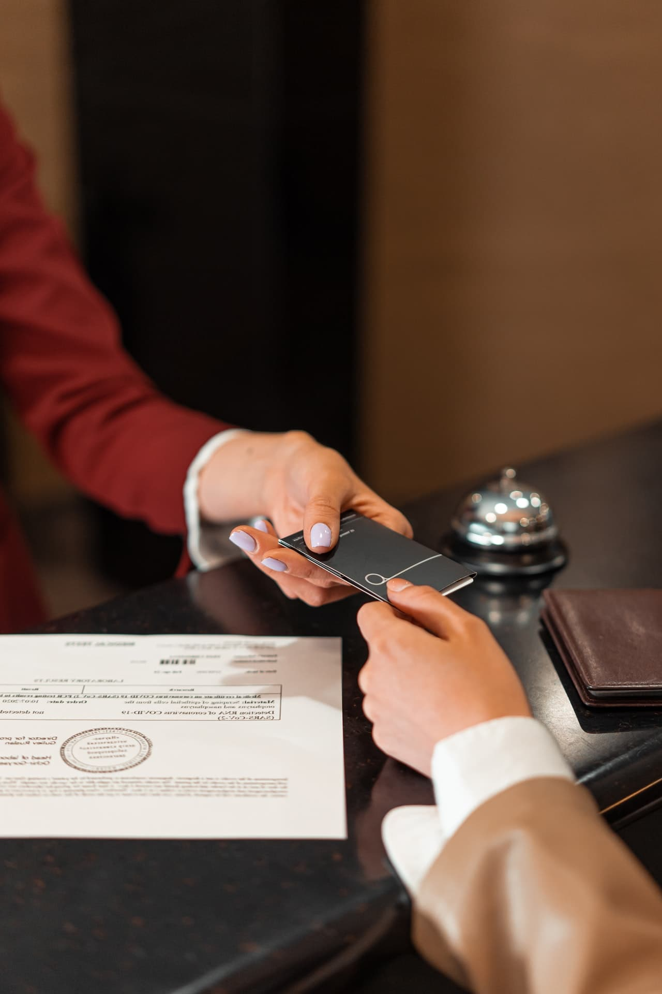
Target users
Guests- expedited check in and check out, limited interaction with staff
Benefit for business travelers, introverts, and late-night arrivals
Self-check-in method to help with long lines
Hotel staff- lighten the load on employees so they can focus on more personalized issues with hotel guests
Management- can view insights from guest arrivals and prioritize other management responsibilities

Slide 5

What this demo will cover
Guests finding a reservation- providing relevant information to their booking to view their hotel room information
Guest Check In- providing information and valid ID number to check into their hotel room(s)
Express Check-Out- Providing information to quickly check out of a hotel room
Hotel Overview- General information about the hotel and its amenities

Slide 6
Future plans
Code to be completed before the Final
Completing the manager-side tasks
Incorporate MySQL- was having issues with connecting to the database
User testing/additional error handling
Any Planned Feature Enhancements
Improving UI- enhancing the homepage and links
Optional- log in screen for management and back buttons for each screen

